Slide 1

Modeling The Temporally Constrained Preemptions of Transient
Prateek Sharma, JCS Kadupitiya, Vikram Jadhao
Intelligent Systems Engineering
Luddy School of Informatics, Computing, and Engineering
Indiana University, Bloomington

Slide 2
Transient Cloud VMs : Opportunities and Challenges
Low-cost VMs that can be preempted unilaterally
Amazon EC2 spot instances, Google Preemptible VMs, Azure delay sensitive

Slide 3
Challenge: How to mitigate preemptions
Two main techniques:
Fault-tolerance (e.g., checkpointing, migration) to
Careful selection of VM type (size, location, etc.)
Require a sound understanding of preemption characteristics
Frequency of preemption -> MTTF -> optimal checkpointing frequency

Slide 4
Preemption Modeling State of the Art
EC2 spot instances extensively analyzed
Historically, price-based preemption allowed easy modeling of preemptions
What about /other/ types of transient VMs?
This paper: Google Preemptible VMs
Flat price -> price-based approaches not applicable
Distinguishing feature: Maximum lifetime of 24 hours.
Temporally constrained

Slide 5
Research Questions
Do GCP VMs have different preemption characteristics?
If so, what is the impact on applications?
Can we develop a model for temporally constrained preemptions?
Policies for checkpointing and scheduling based on the model

Slide 6
Outline
Motivation
Empirical Analysis
A Reliability Model for Temporal preemptions
Model based policies
SciSpot framework
Experimental Evaluation
Related Work

Slide 7
Empirical analysis of preemptions
Flat pricing -> Empirical approach required
Collected 1000 preemption data
Regions, types, time of day etc.
Measure time to preemption

Slide 8
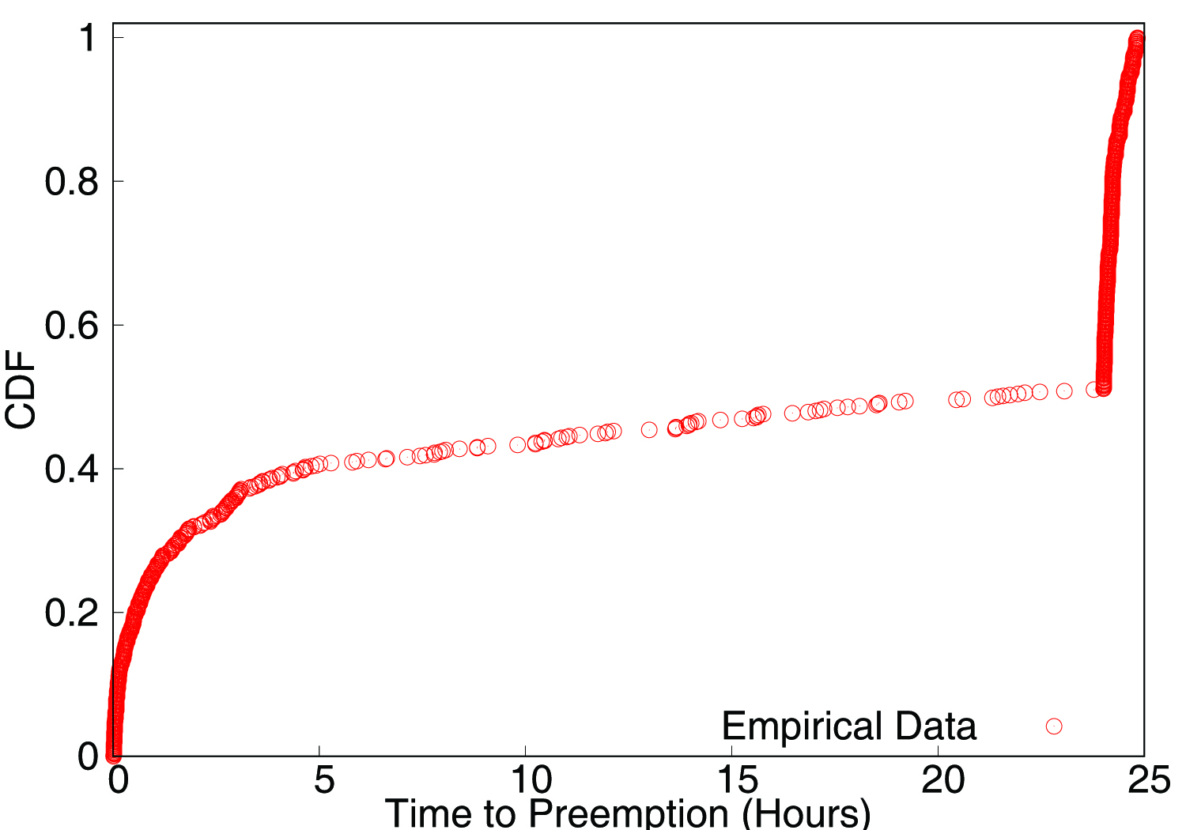
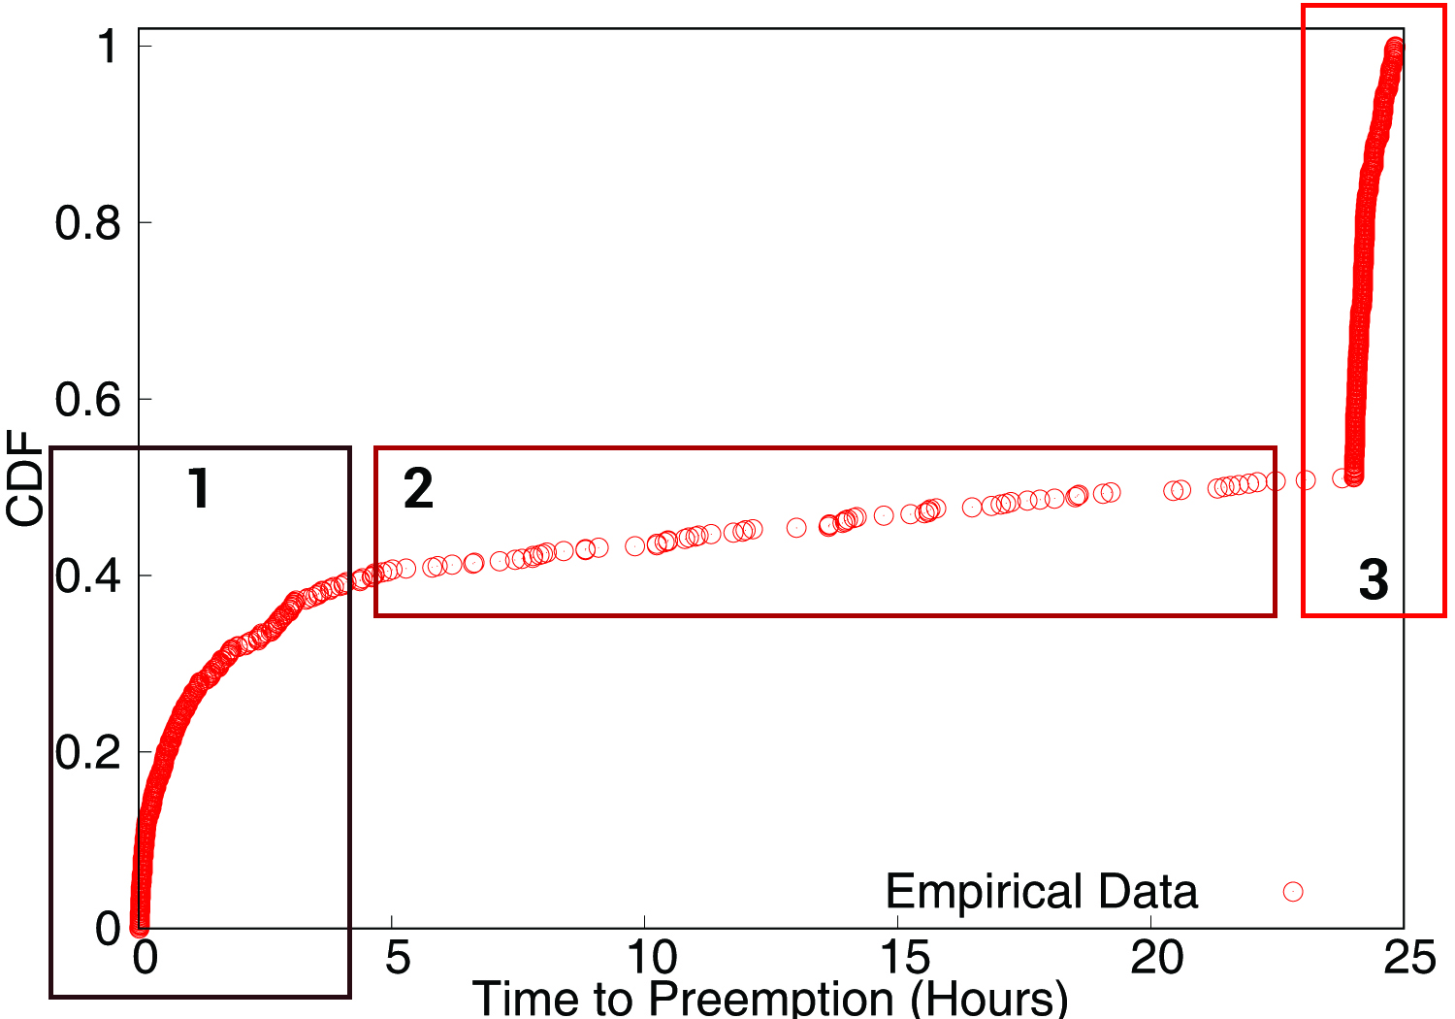
Observation 1: Preemptions are Bathtub shaped
Preemption rates are non-uniform and have three distinct phases:
Initially [0-4 hrs]: High rate of preemptions
Middle period: Low preemption rate
Near deadline: High rate

Slide 9
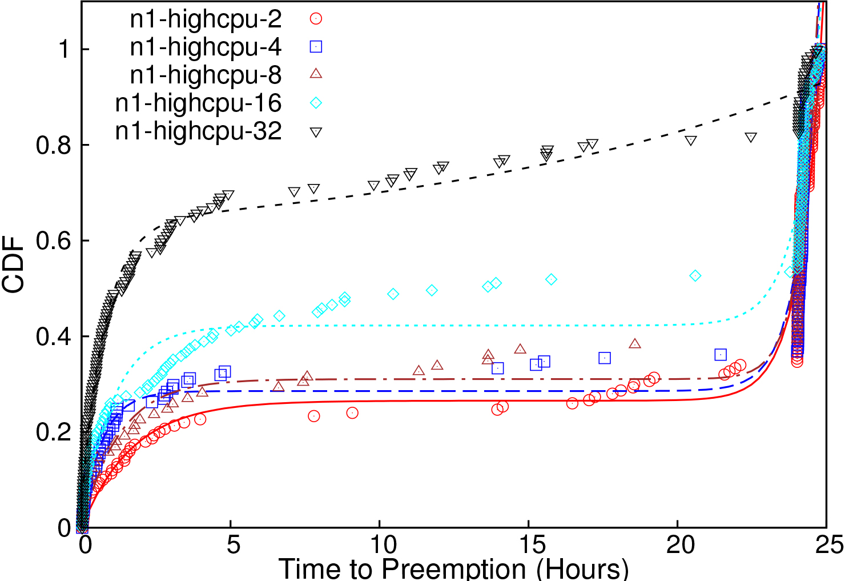
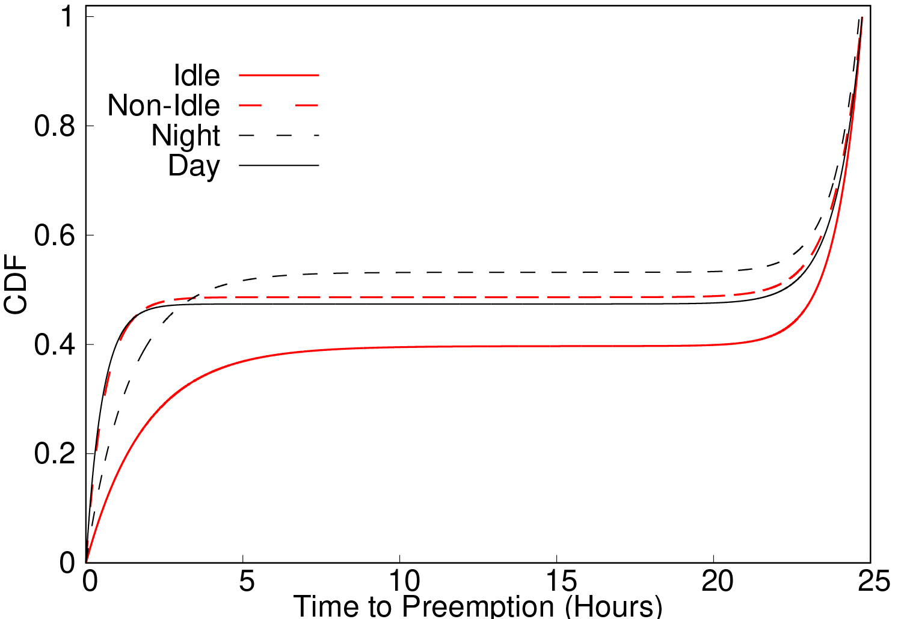
Observation 2: Holds across different types and times
Preemption characteristics depend on type of VM, time of day, and region
General bathtub shape with the different failure rates

Slide 10
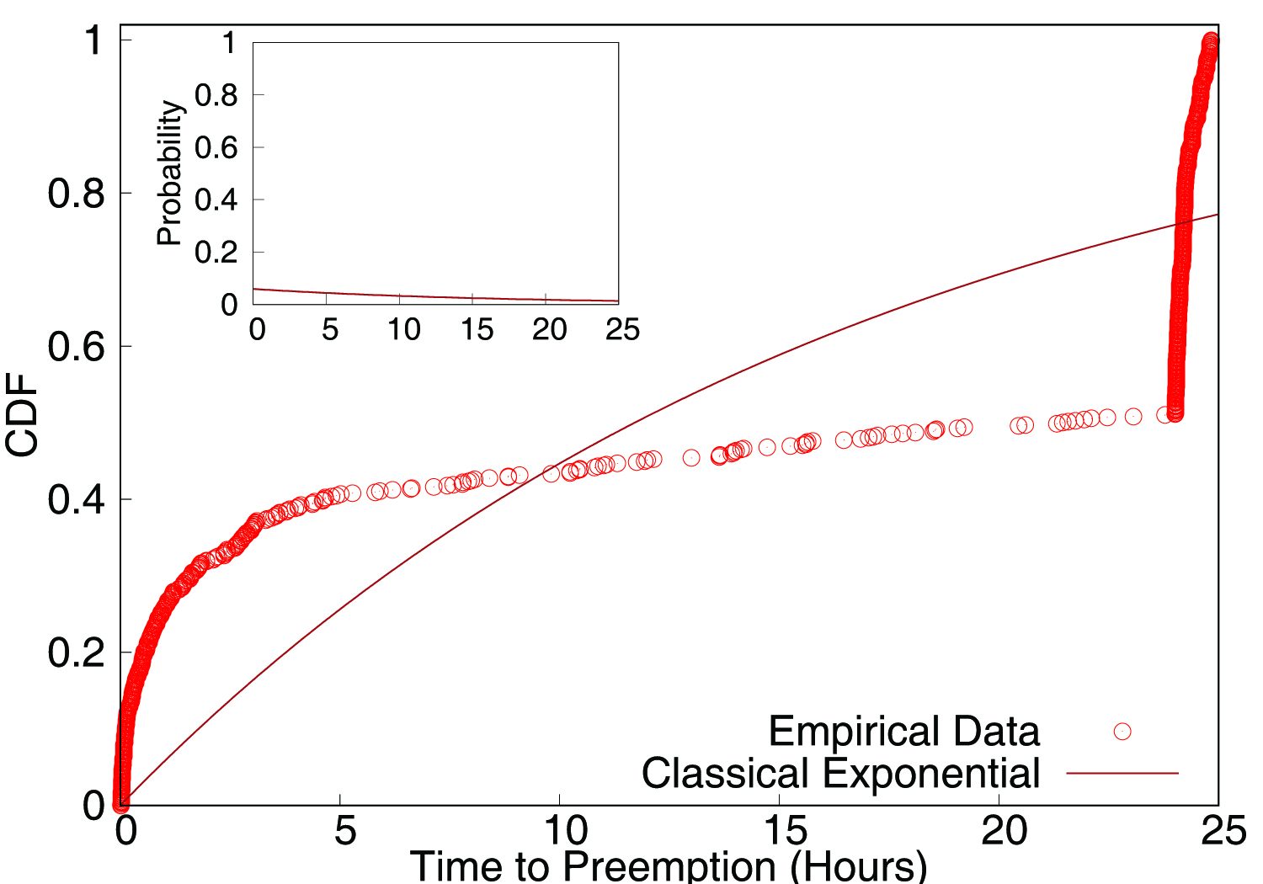
Constrained Preemptions are Not Memoryless
Conventional reliability modeling, memoryless exponential failures:
Also used to model EC2 spot preemptions.
MTTF = 1/Failure-rate
Different preemption phases -> Memoryless models not applicable

Slide 11
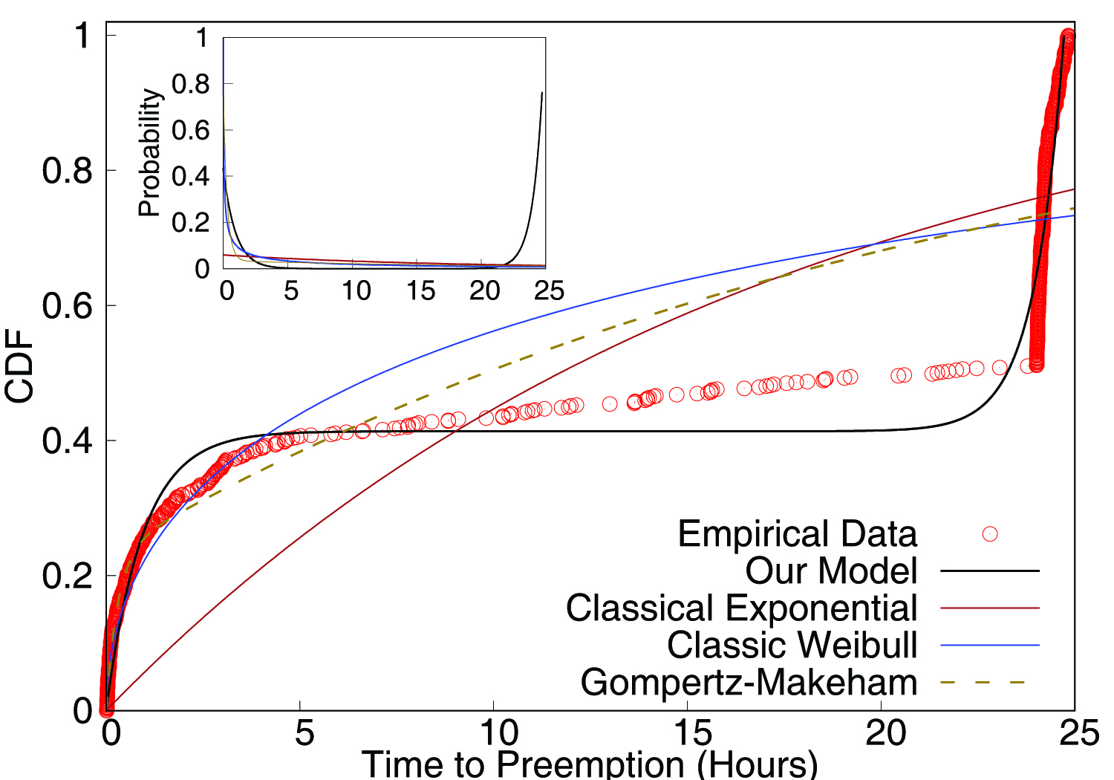
Constrained Preemptions are Difficult to model with existing failure distributions
Can we fit preemptions using other failure distributions?
Weibuill: Generalized form of exponential used to model bathtub failures
Gompertz-Makeham: Popular in actuarial science. Captures early deaths and accelerated aging.
Temporal constraint -> challenging to fit an existing failure model

Slide 12
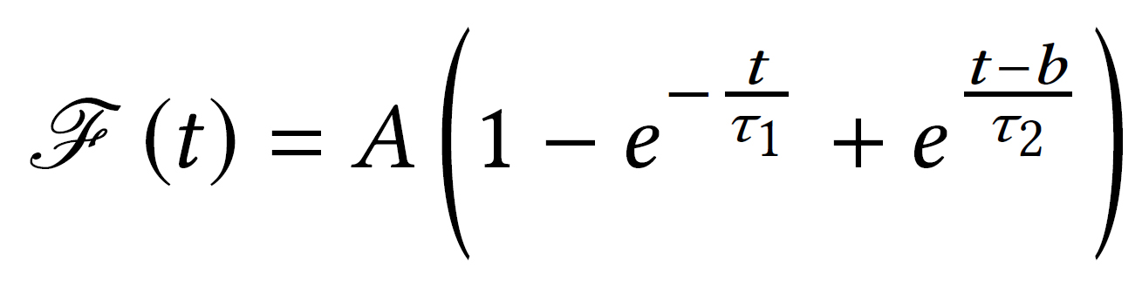
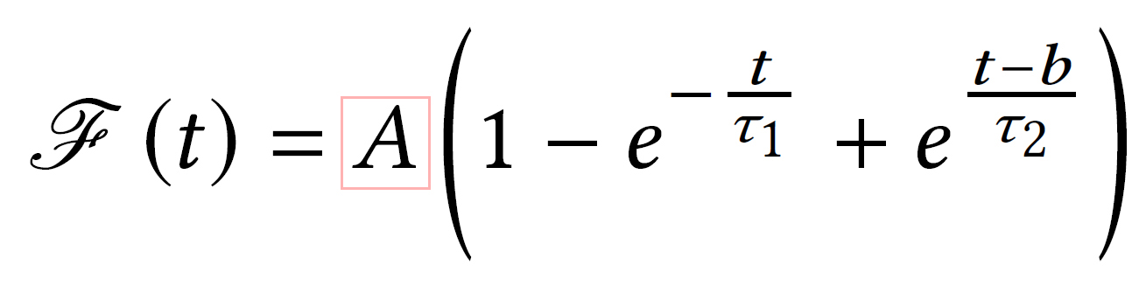
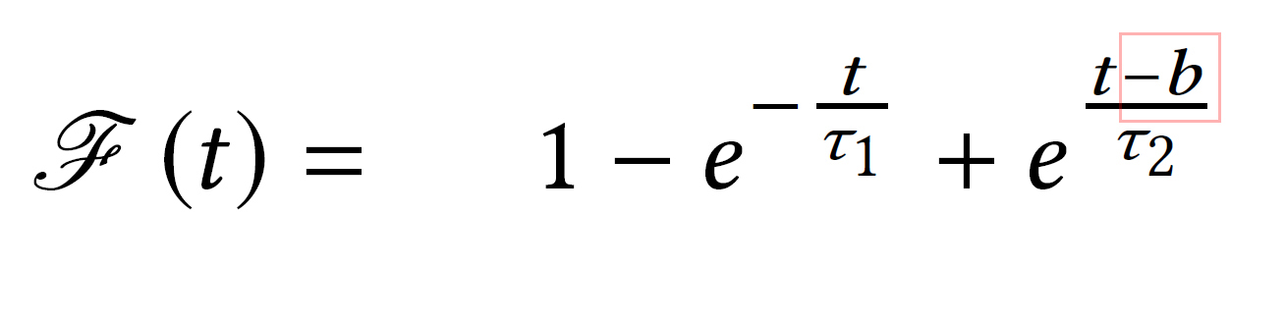
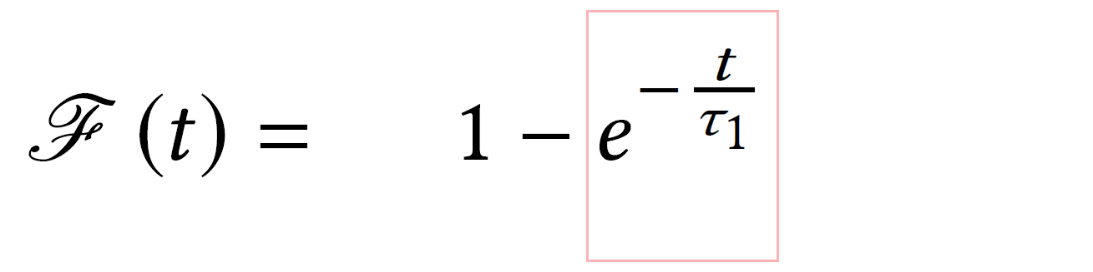
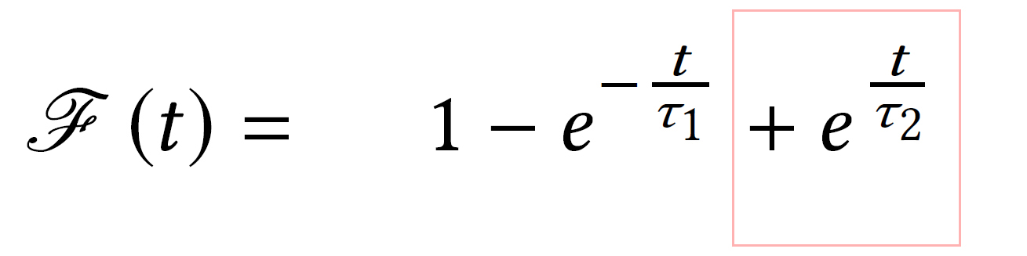

Our Model For Temporally constrained preemptions
Intuition: 2 failure processes.
Classical exponential failures during initial and middle parts
Positive exponential near the deadline
Our model uses four parameters:
$\text{τ}\text{1}$: rate of preemptions of initial phase
$\text{τ}\text{2}$: preemption rate near deadline (final phase)
$\text{b}$ : Activation time of final phase
$\text{A}$: Scaling constant

Slide 13
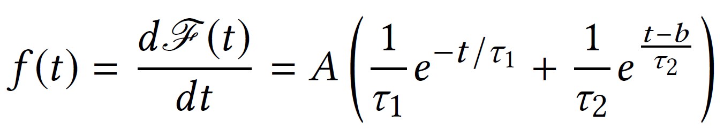
Model Characteristics
Fit using least squares
Able to capture differences between VMs
Figure 2 from earlier
Differentiable everywhere => preemption density functions is:

Slide 14
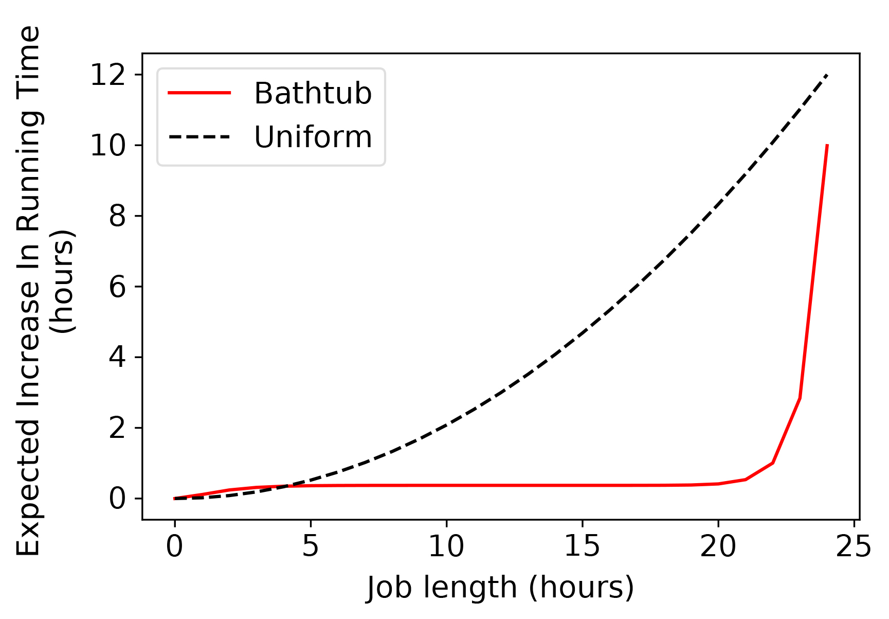
Impact on Application Performance
Bathtub preemptions significantly different from uniform preemptions
Preemption probability of a job depends on the age of the VM and the job length
Takeaway:
Bathtub preemptions beneficial for jobs > 5 hours
Let VM “mature”, then run job

Slide 15
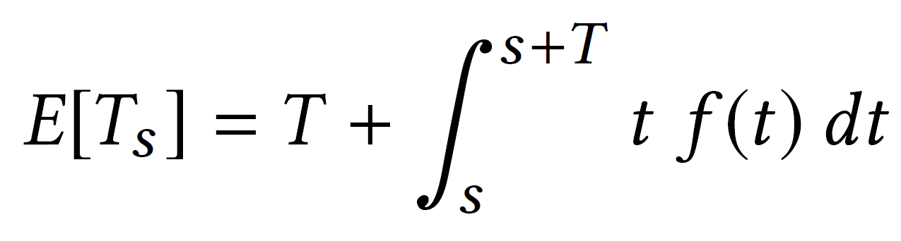
Job Scheduling and VM Reuse Policy
Tradeoff faced by jobs: either continue running on an “old” VM, or run on a newly launched VM.
New VMs have high initial preemption rate
Reusing a VM: preemption probability depends on age of VM and job length

Slide 16
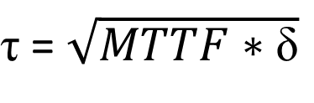
Checkpointing Policy
$\text{τ}$ = $\sqrt{MTTF∗\text{δ}}$
Classic Young-Daly approach: , where $δ$ is checkpoint write time
Non-uniform preemption rates -> rates not ideal
Our approach: Use Dynamic Programming to compute the “optimal” checkpointing schedule for a job

Slide 17
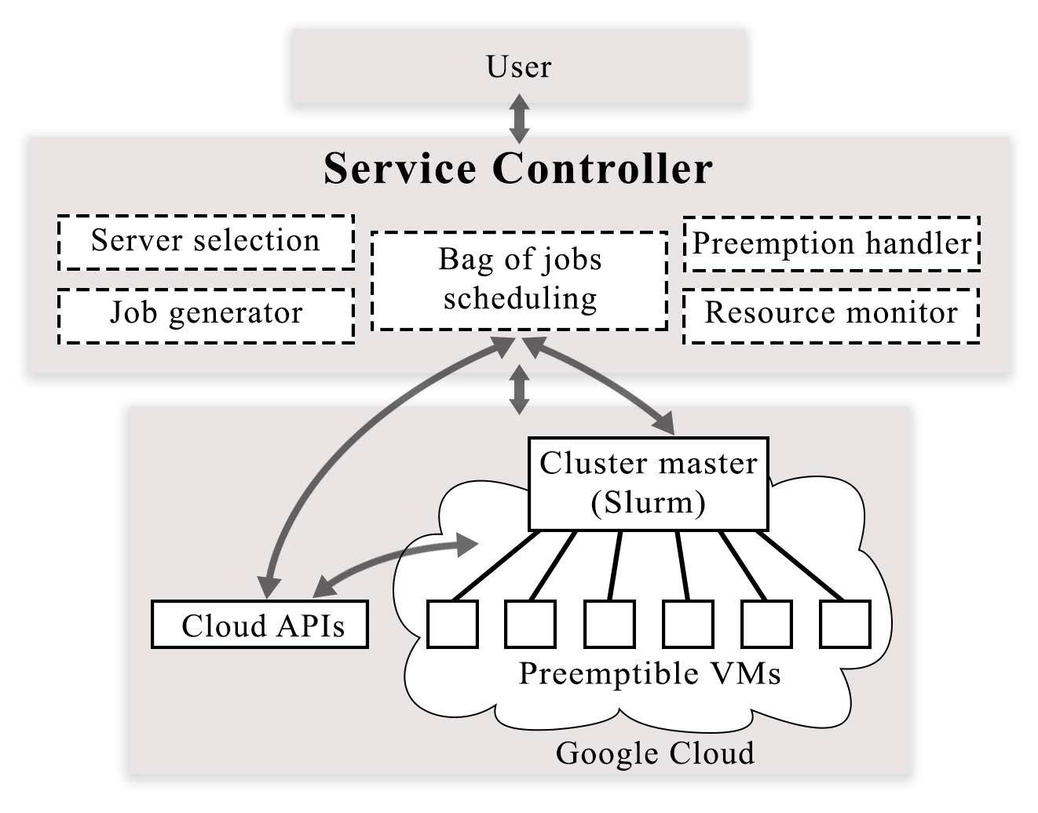
SciSpot: A Batch Computing Service
Implemented a system for running scientific computing applications on Preemptible VMs
One more sentence here…

Slide 18
Evaluation setup
Simulation workloads:
LULESH
Nanoconfinement
Shapes

Slide 19
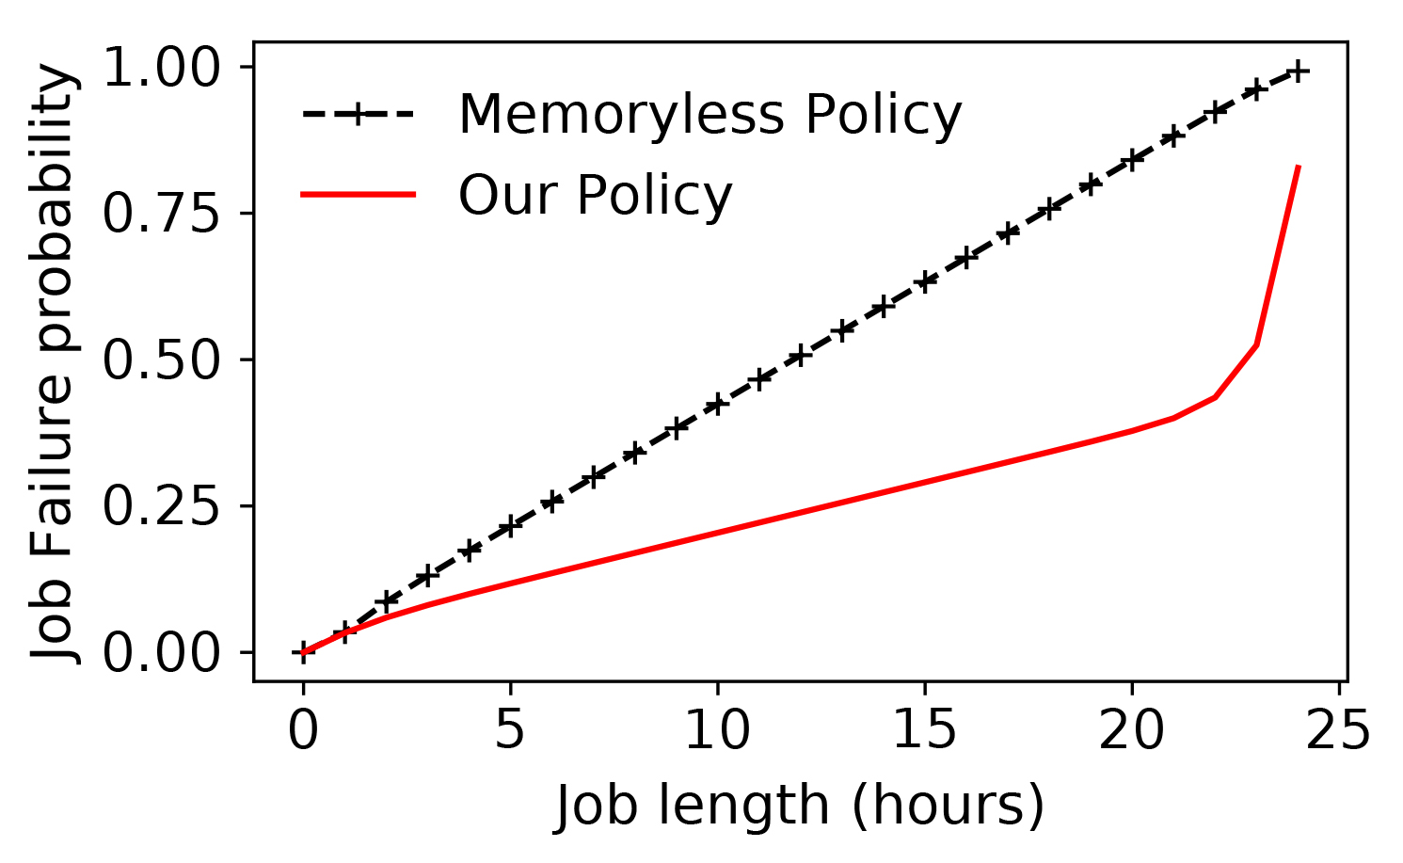
Job failure reduction
VM reuse policy does not launch jobs near the end of the VM’s lifetime.
Job failure probability is reduced by up to 3x

Slide 20
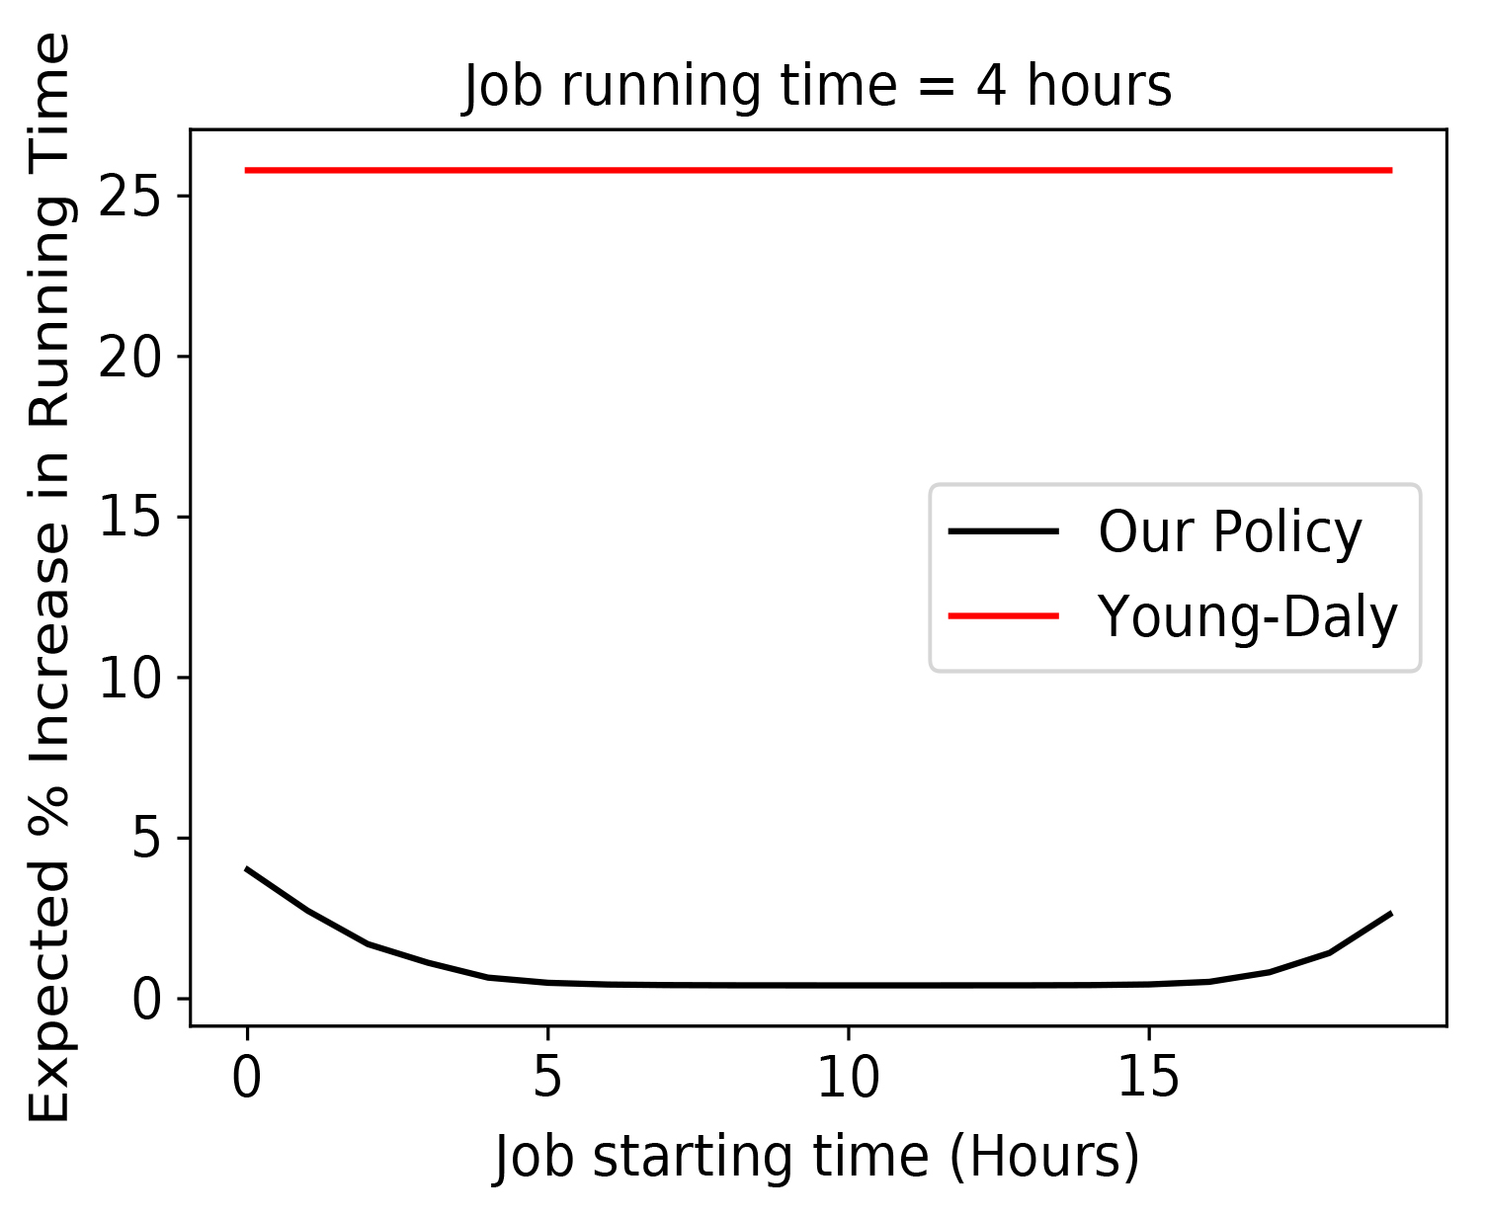
Checkpointing overhead
Checkpointing overhead is lower with our policy
Young-daly with initial high failure rate: higher frequency and overhead
Better than YD

Slide 21
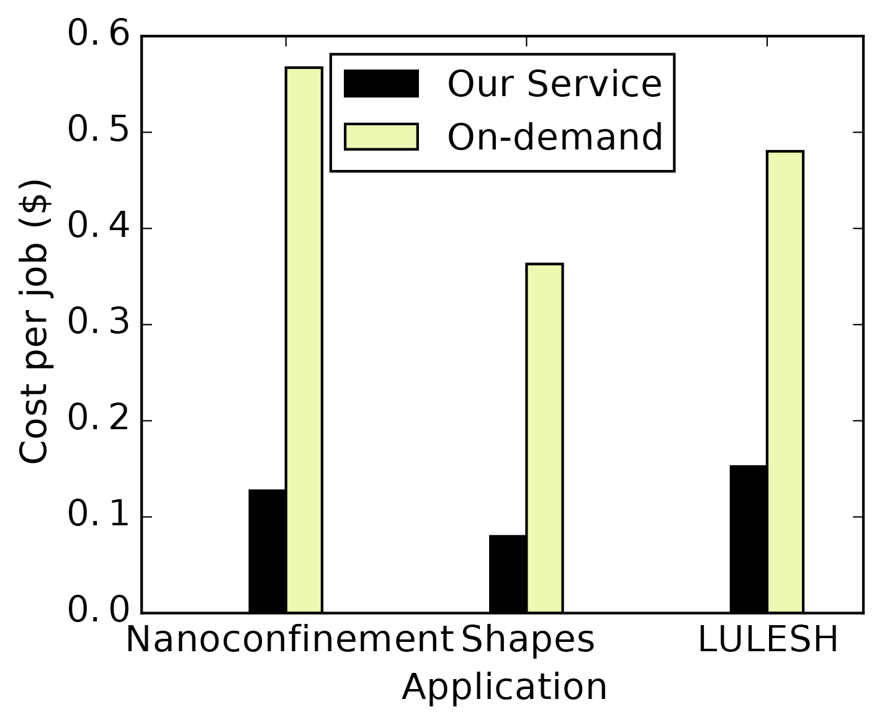
SciSpot eval?
Costs are low
Early preemptions plus low means overhead is low

Slide 22
Related Work
Spot price modeling
Systems using google preemptible VMs
Failure modeling

Slide 23
Future Directions
What if preemption characteristics change?
This paper studies the fundamental characteristics of temporally constrained preemptions
Current model fairly robust as long as general bathtub shape is maintained
Model drift can be detected when model specifics change
Simpler models for constrained preemptions
Phase-wise model: Fit separate models to the 2/3 different segments

Slide 24
Conclusion
Google Preemptible VMs: 24 hour lifetime
Temporally constrained preemptions: new type of transient resource availability
Empirical study of >1000 preemptions shows bathtub, and not uniform preemptions
We develop a multiple failure rate model
Scheduling and checkpointing policies improve job running times by _X.

Slide 25
END
Thank You!

Slide 26
Scratch
How frequently preemptions occur?
Useful for fault-tolerance policies such as periodic checkpointing.
Huge amount of analysis for EC2

Slide 27
What about other transient servers?
Preemption models are different
This paper: focus on temporally constrained preemptions
Google preemptible: 24 hour max lifetime

Slide 28
Why
Allow principled policies
New type of preemption model that is not governed by price
May not be memoryless due to temporal constraint

